Slide 1
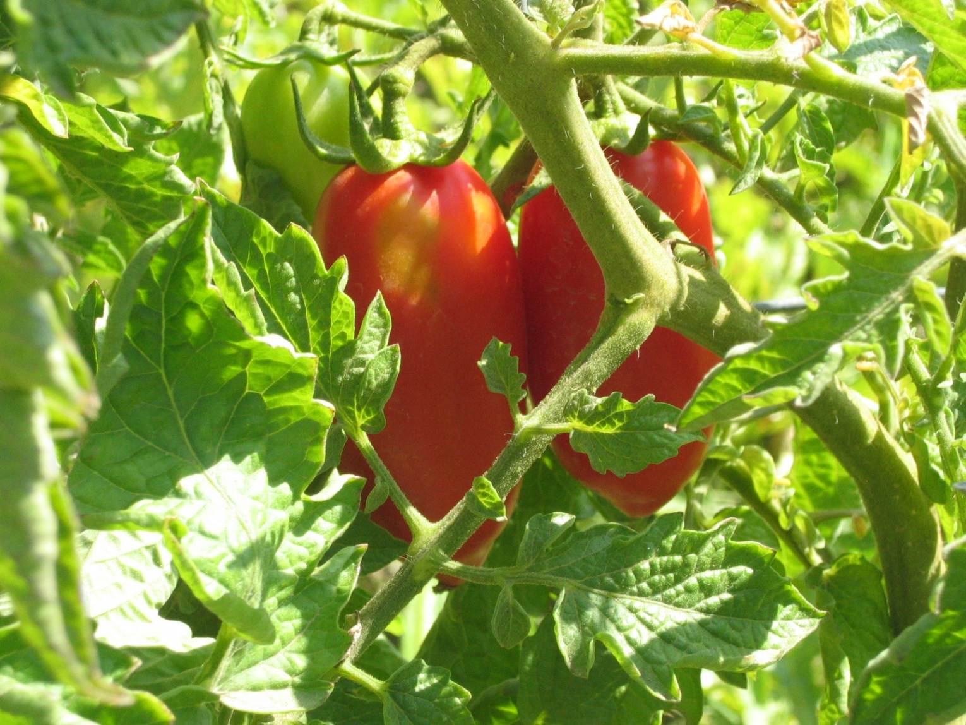
Garden Deliverables
Module 10 - Garden Ecology Lesson 7: Garden Deliverables
“From Farm to Fork”

Slide 2
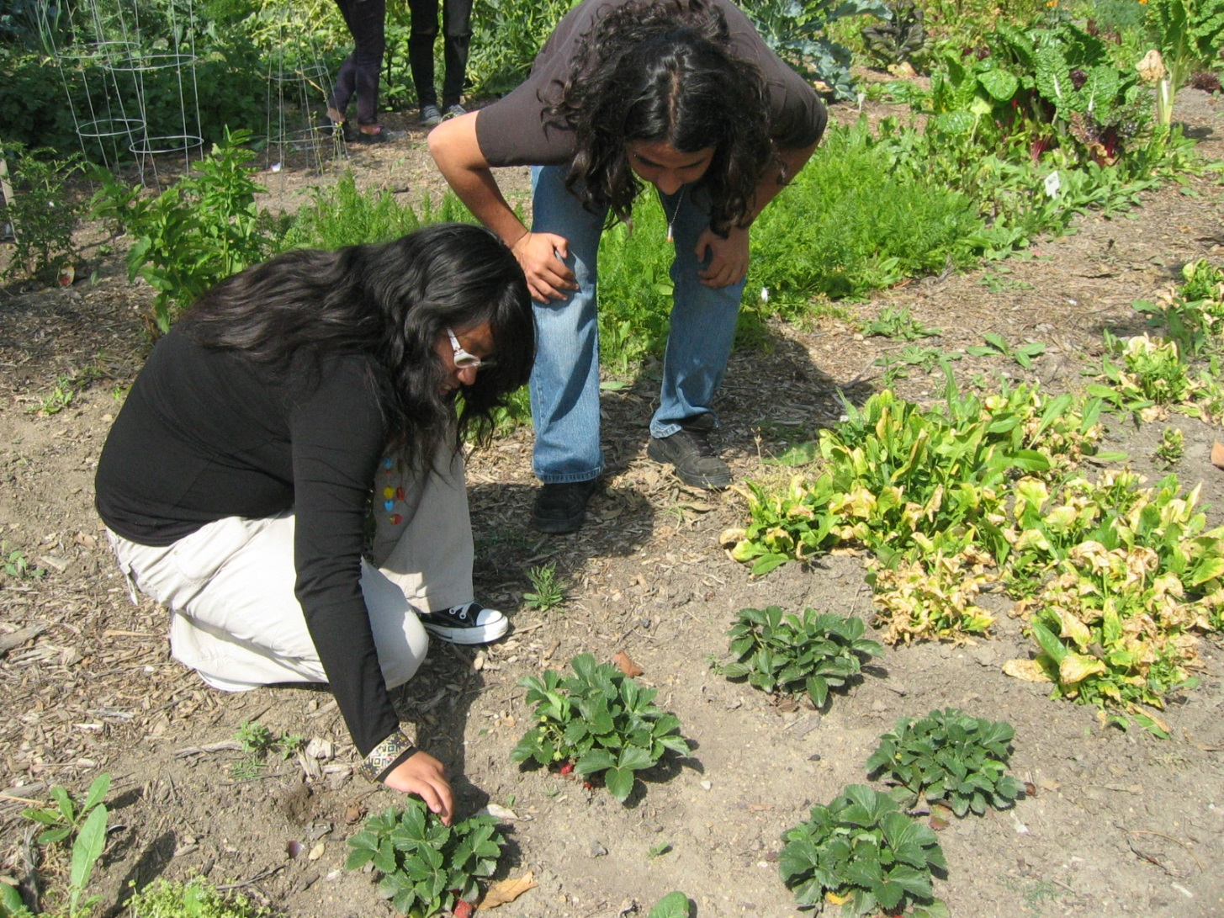
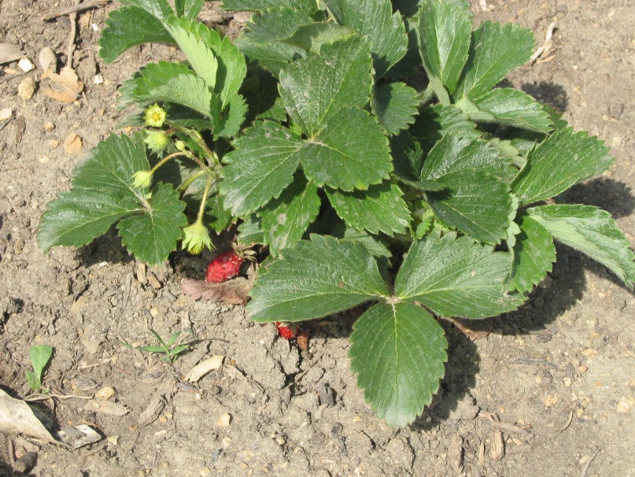
Whether it’s Fruit….
Strawberries

Slide 3
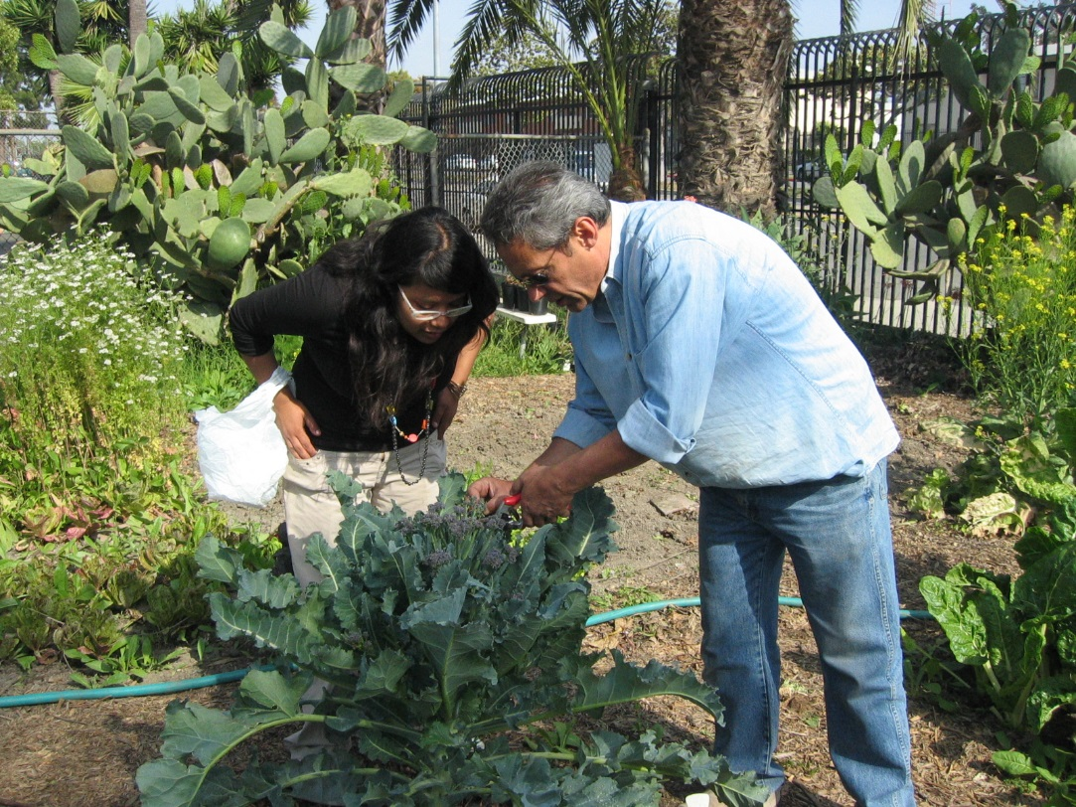
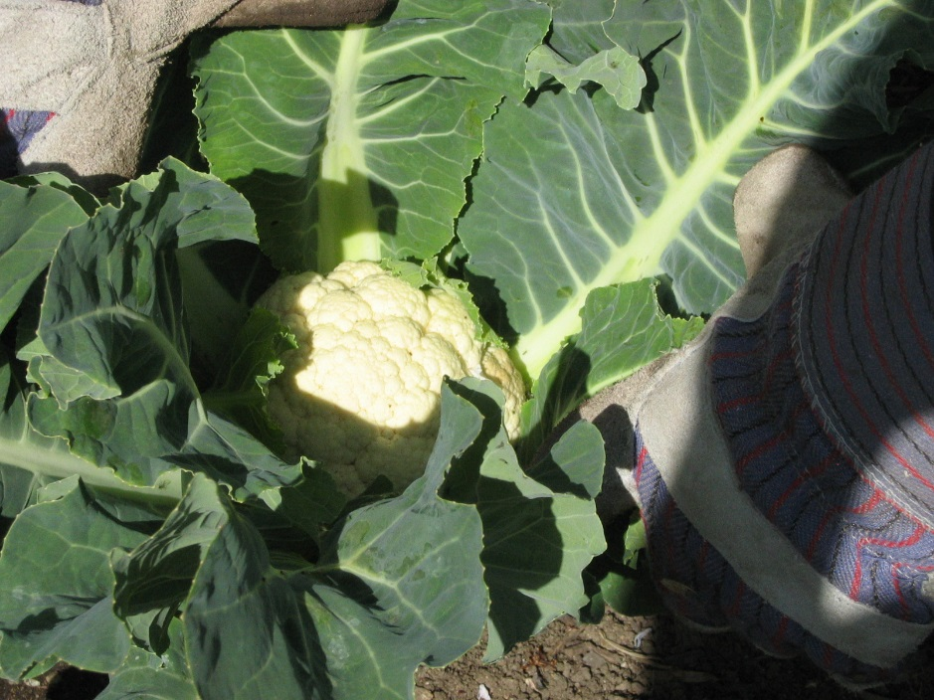
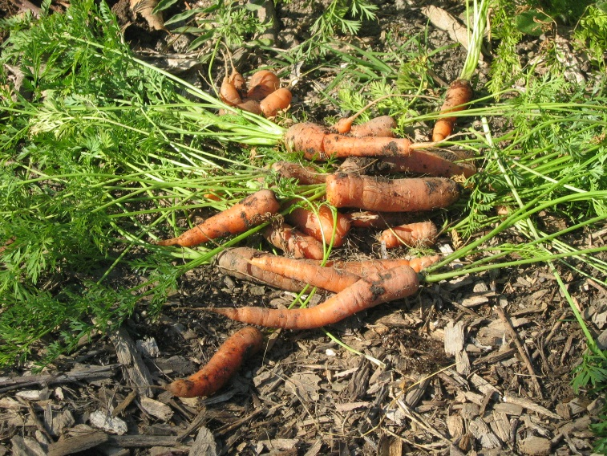
Whether it’s Vegetables….
Cauliflower
Broccoli
Carrots

Slide 4
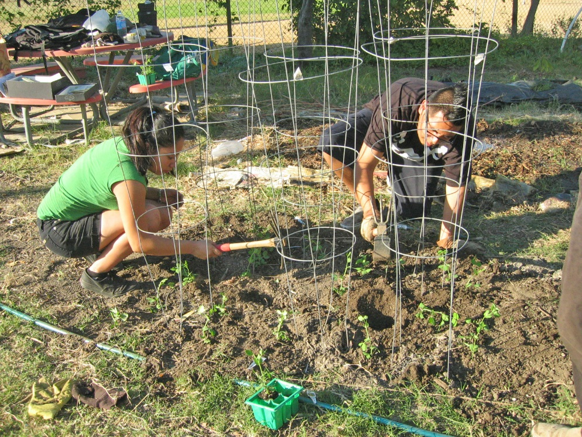
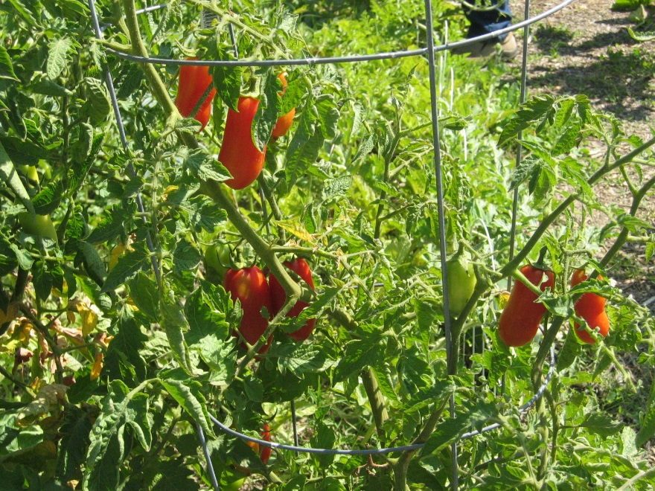
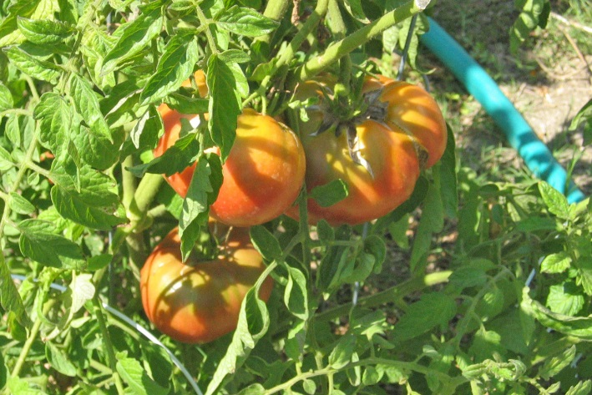
Whether it’s More Vegetables….
Tomatoes

Slide 5
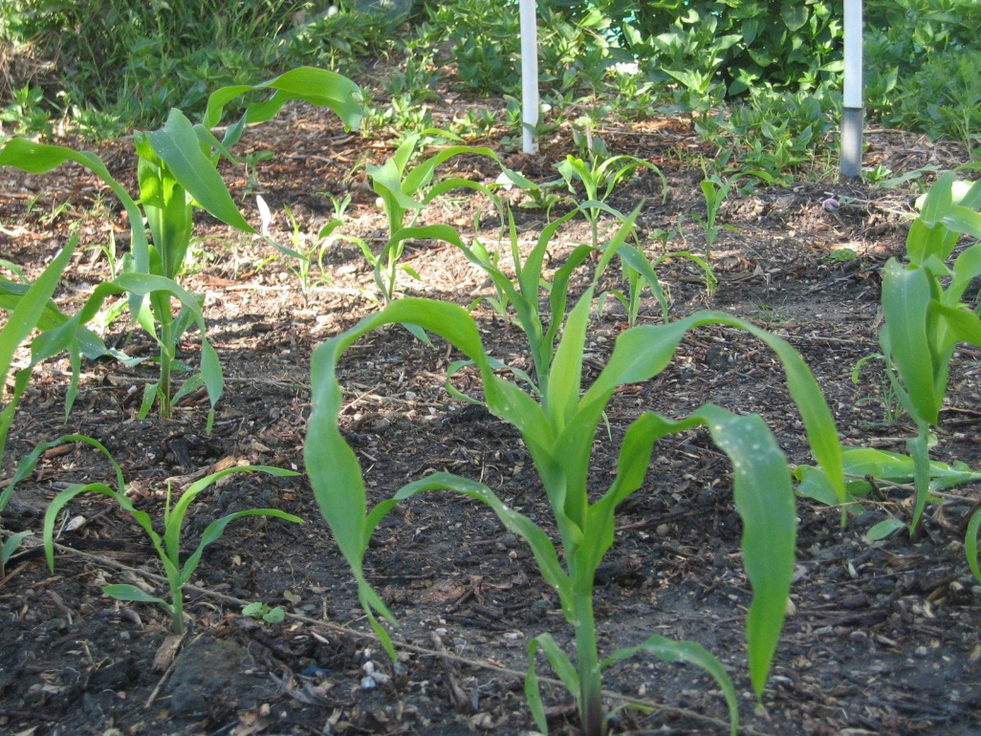
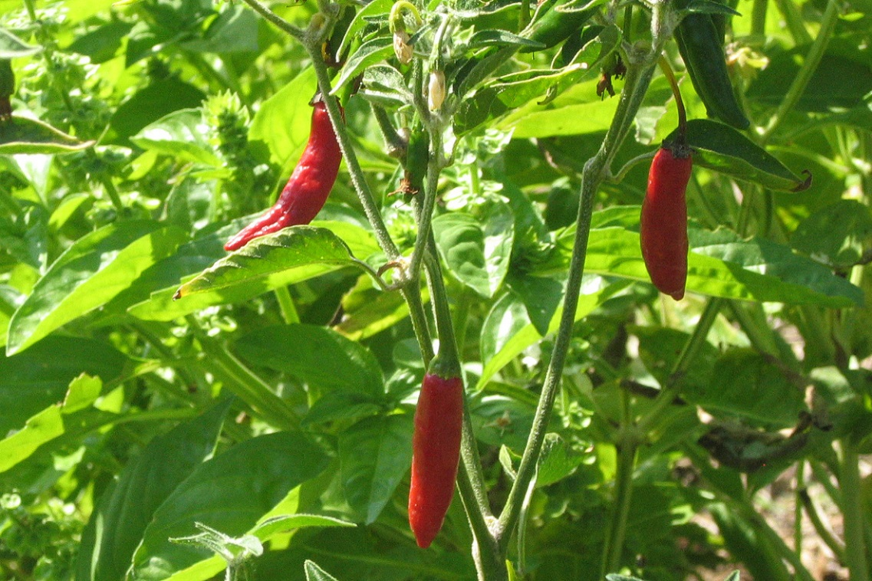
… And More Vegetables….
Corn
Peppers

Slide 6
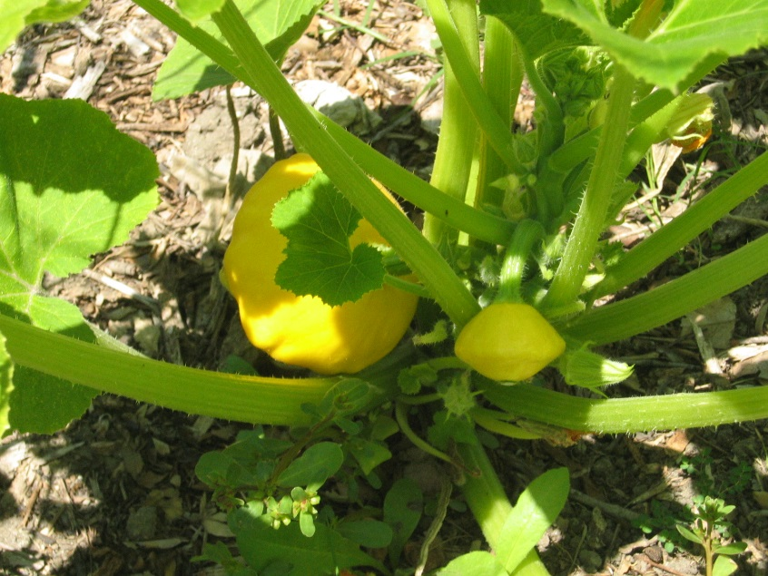
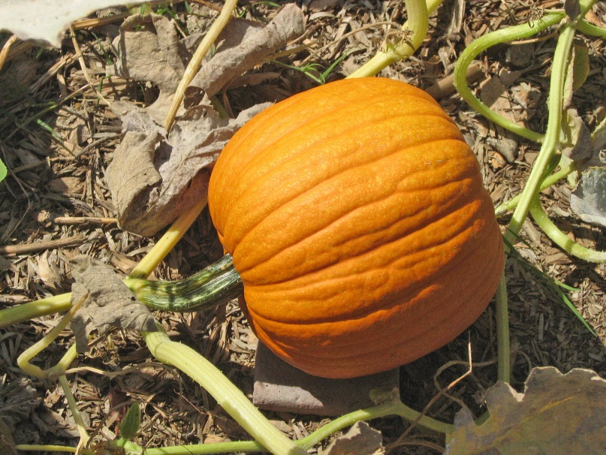
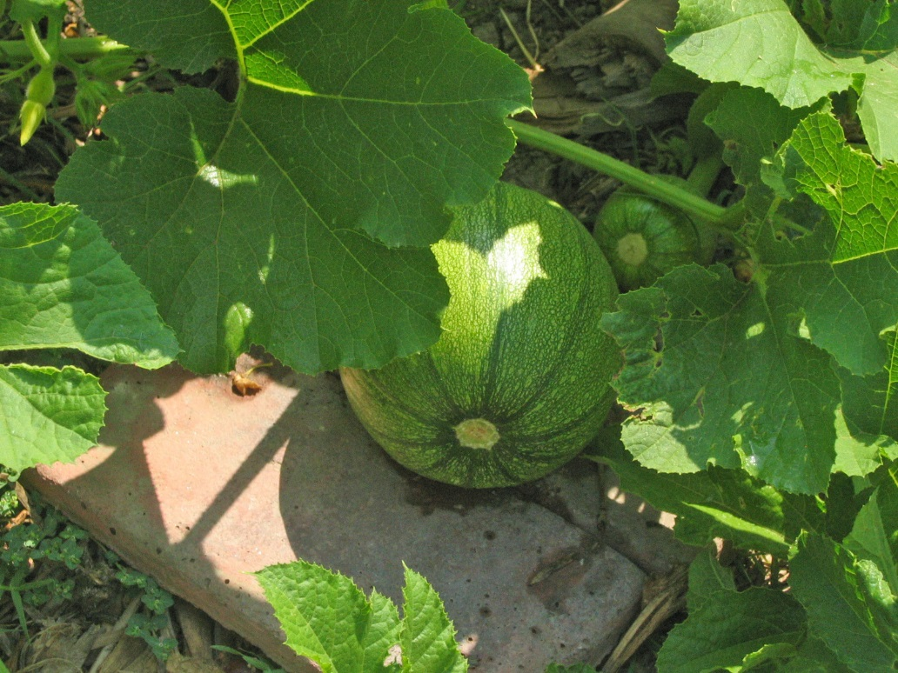
Whether it’s Pumpkins, Melons and Squash….

Slide 7
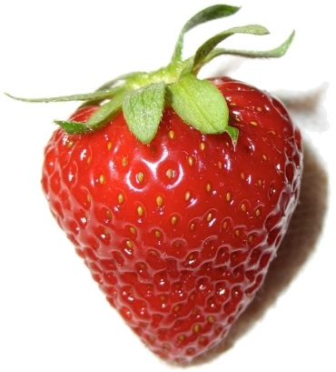
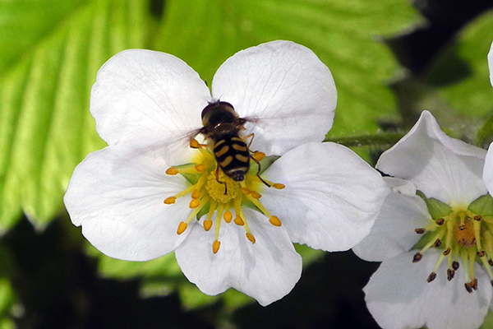
Or flowering plants (providing nectar)….
By Rlaferla, CC BY-SA 3.0, https://commons.wikimedia.org/w/index.php?curid=20573474
Bees are critical to making strawberries bigger, redder, and longer-lasting. Technically, strawberries can pollinate themselves, but the resulting berries are small. That’s because a strawberry is really a collection of tiny fruits that all meld together into one delicious morsel. Each of those tiny fruits has to be individually pollinated. Without bees, that doesn’t happen.
https://mywoodlot.com/item/enjoying-a-strawberry-thank-sixty-bees

Slide 8
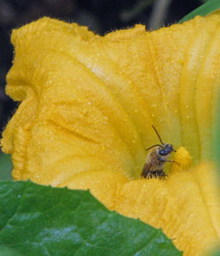
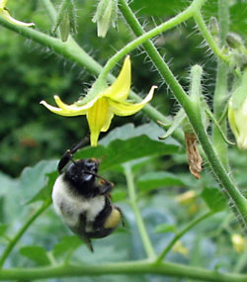
Or observing the pollination process…
Squash plants have male and female flowers. (The squash develops from the female flowers).
The bees do the work of pollinating the flowers so the squash develops. No bees, no squash!
Although wind can do the job, tomatoes benefit greatly from bumblebees' special "buzz pollination.“
Some experts recommend tapping each flower cluster a couple of times a day with a pencil, but we'd much rather provide an appealing habitat for bumblebees and let them do the work—as nature intended.
http://www.ourediblegarden.org/gardening/pollination.html

Slide 9
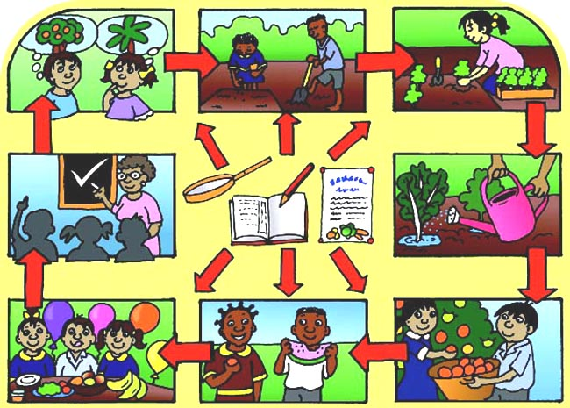
It’s all about
WHAT’S LEARNED ALONG THE WAY!
Bear in mind that a school garden is not like projects which stand or fall by whether they meet their production targets. It is a learning experience, so the process is as important as the product. Success is good for motivation, but small failures are interesting and instructive. Production objectives are not written in stone. Some may be dropped because of circumstances, or replaced with more interesting ones. Equally you may have to give up some gardening ambitions if educational needs are more important. Having a mid-term review of objectives and progress is always a good idea.
Taken from Setting up a school garden http://www.fao.org/docrep/009/a0218e/A0218E11.htm

Slide 10
Success with Edible Garden Deliverables
begins with …
Having a plan
Knowing the harvest times (when will fruits and vegetables ripen?)
Knowing the plants’ growth cycles
Being aware of weather and the climate of the region
Dividing tasks / Sharing in the work
Maintaining the garden – having schedules for:
Weeding
Watering
Soil Amending / Fertilizing (if needed)
Protecting plants during bad weather (freezes, storms…)
Thinning Vegetables (radishes, carrots …)
Harvesting
Distributing produce for consumption (don’t let it spoil!)

Slide 11
Other Tips for a Successful Edible Garden …
Start small
Have a weekly schedule
Solicit volunteers to help with students out in the garden, and to cover the tasks when students are on vacation
Use an electronic garden planner that takes the guess-work out of planting times, harvesting times, etc.; A great one to use is Farmer’s Almanac Garden Planner:
https://gardenplanner.almanac.com/gardenplanner/gardenplanner.html#

Slide 12
Setting Up and Running a School Garden. Toolkits for Teachers
A MANUAL FOR TEACHERS, PARENTS AND COMMUNITIES
http://www.fao.org/docrep/009/a0218e/A0218E11.htm
Available electronically on-line at: www.fao.org/docrep/009/a0218e/a0218e00.htm,
or in Spanish (Crear y manejar un huerto escolar) at: www.fao.org/docrep/009/a0218s/a0218s00.htm
Ellen Muehlhoff (ed), 2005 Published by the Food and Agricultural Organisation, Rome Spiralbound, 208pp, ISBN 92 5 105408 8
Food and Agriculture Organization of the United Nations Rome, © FAO 2005
Front cover:
School children in China: R. Faidutti.
School garden in Panama: Jesús Bulux, Instituto de Nutrición de Centro América
y Panamá and Pan American Health Organization.
Vegetables and fruit: Mel Futter.

Slide 13
Other School Garden Resources
https://www.bgci.org/education/2257/
https://www.growveg.com/guides/how-to-set-up-a-school-garden/
https://www.treehugger.com/culture/setting-up-and-running-a-school-garden-toolkits-for-teachers.html
https://gardenplanner.almanac.com/

